Slide 1
3u3 CubeSat Instrument Response
By: Daniel Abel
10/05/2023

Slide 2
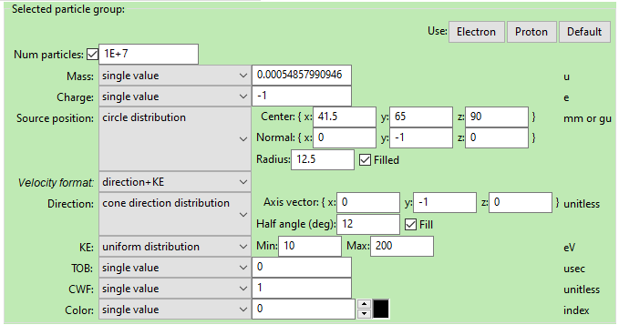
Starting Population Definition for 0deg centerline
Exponential Decay between 10-200

Slide 3
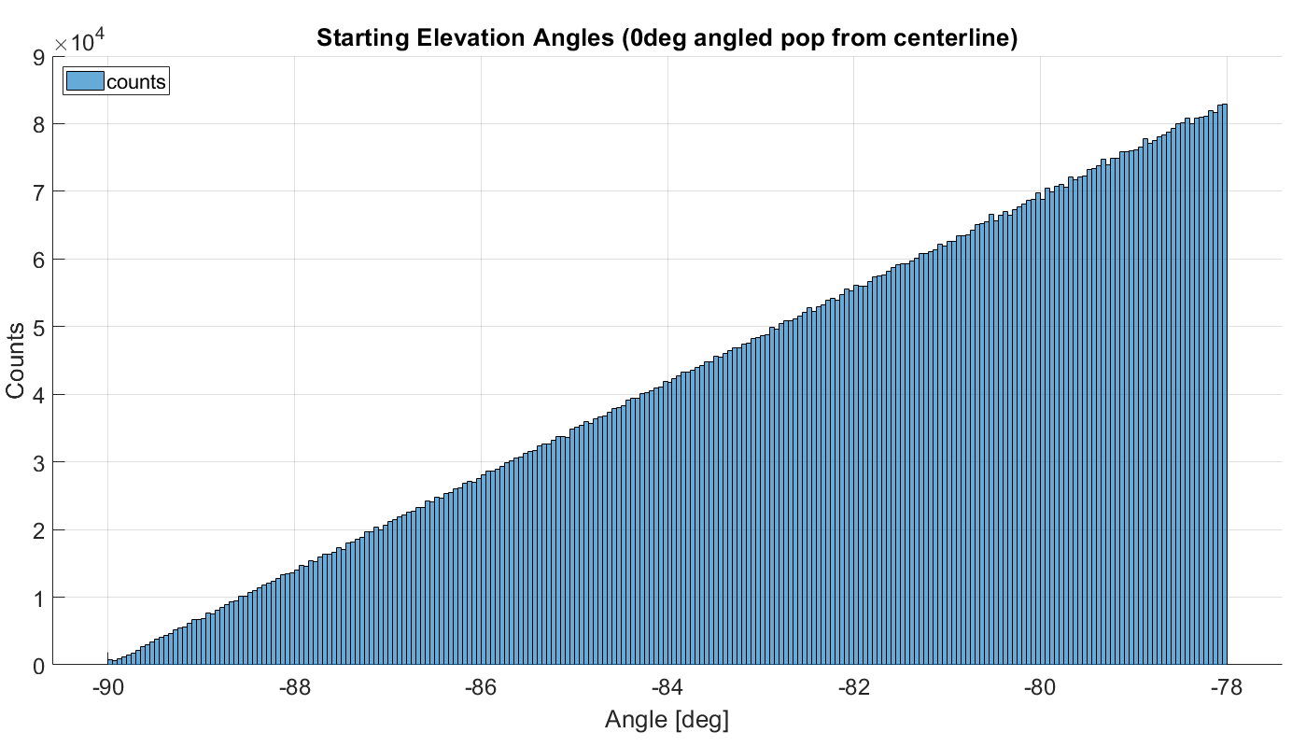
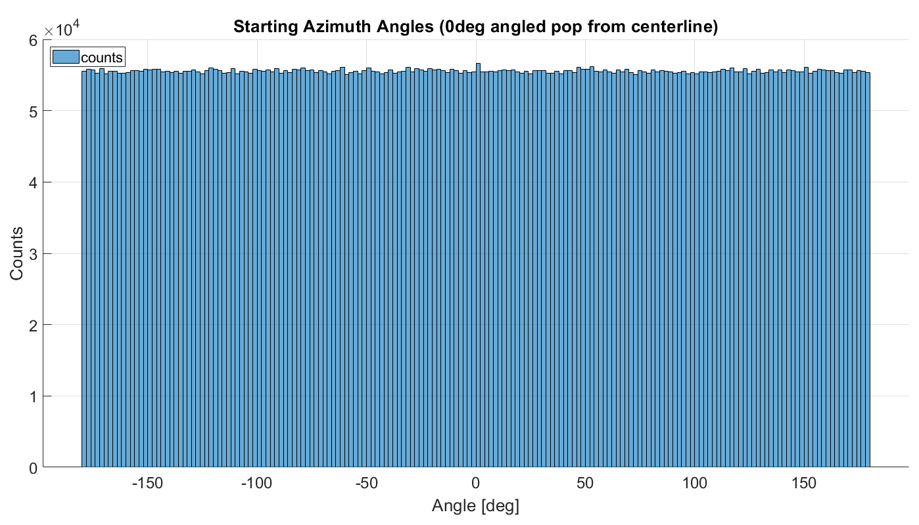
Starting Population Definition Cont. for 0deg from instrument centerline
These graphs are for the 10eV population*
The other particle populations are not identical but have the same definition in SIMION besides energy

Slide 4
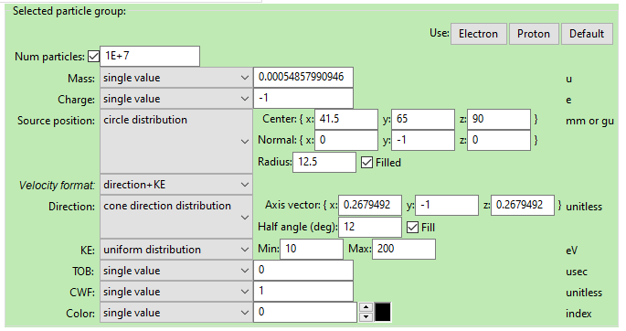
Starting Population Definition for 20.75deg centerline
Exponential Decay between 10-200

Slide 5
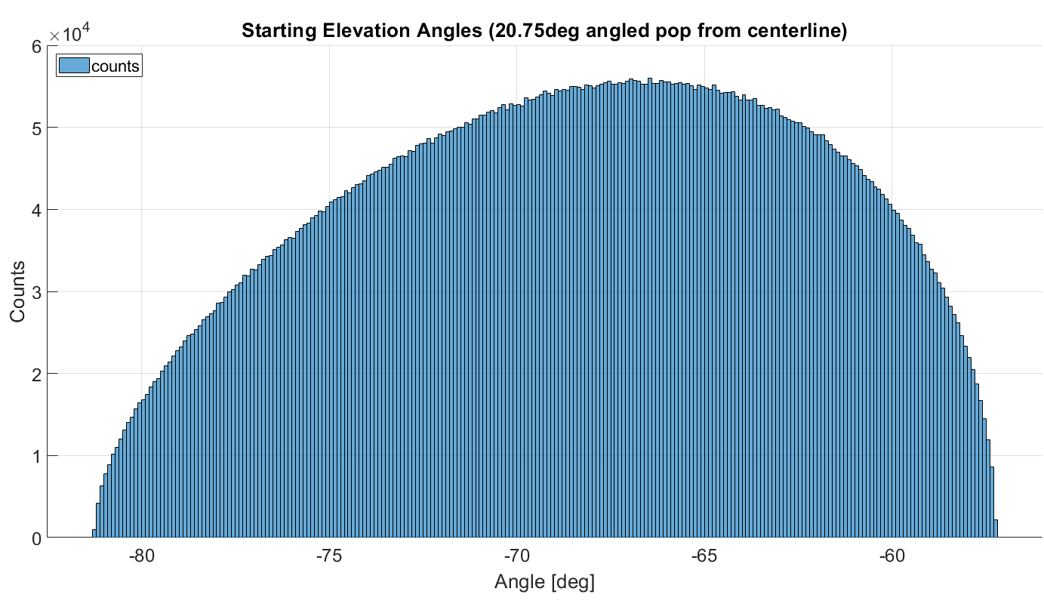
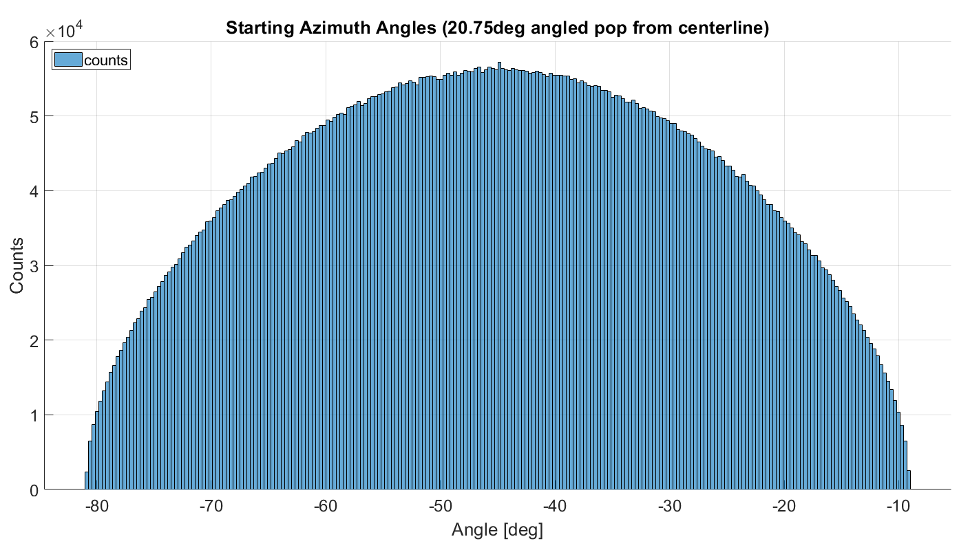
Starting Population Definition Cont. for 20.75 deg from instrument centerline

Slide 6
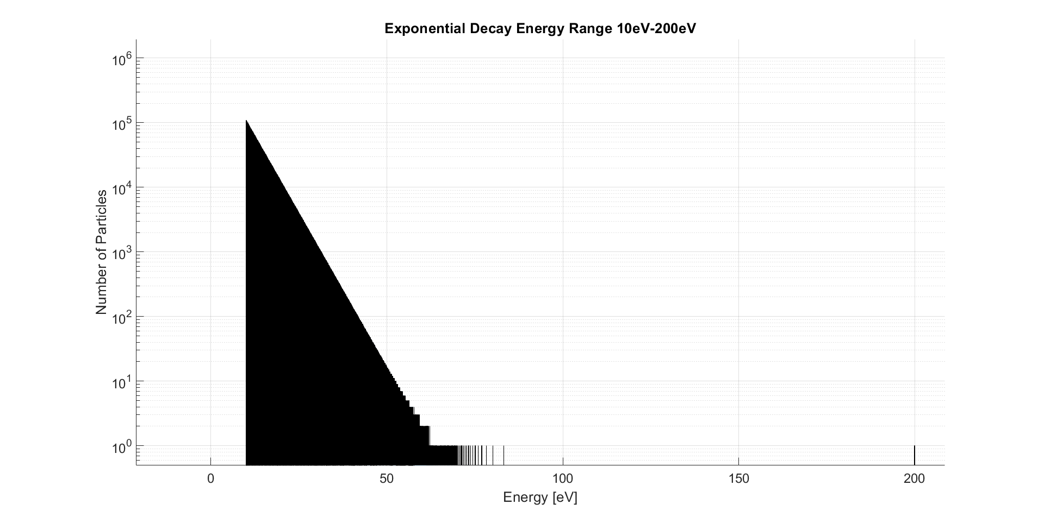
Exponential Decay Energy Distribution

Slide 7
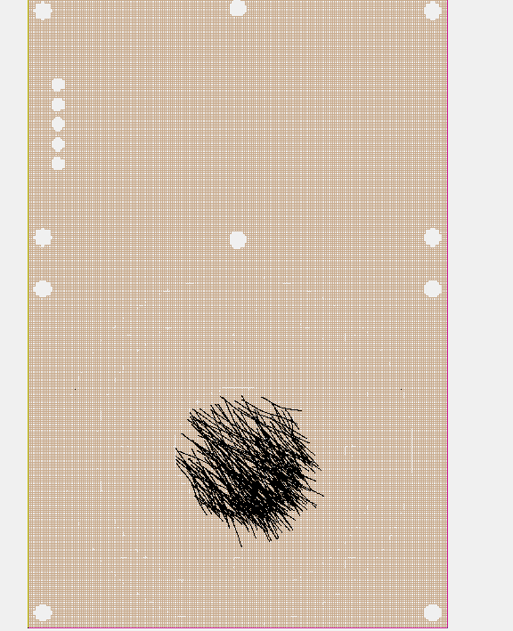
Particle Population Orientation
Particle directions are oriented toward the bottom left corner (45deg) and toward the viewer here
Then the 12deg angular range is applied.
This is a bottom-up view
12deg
12deg

Slide 8
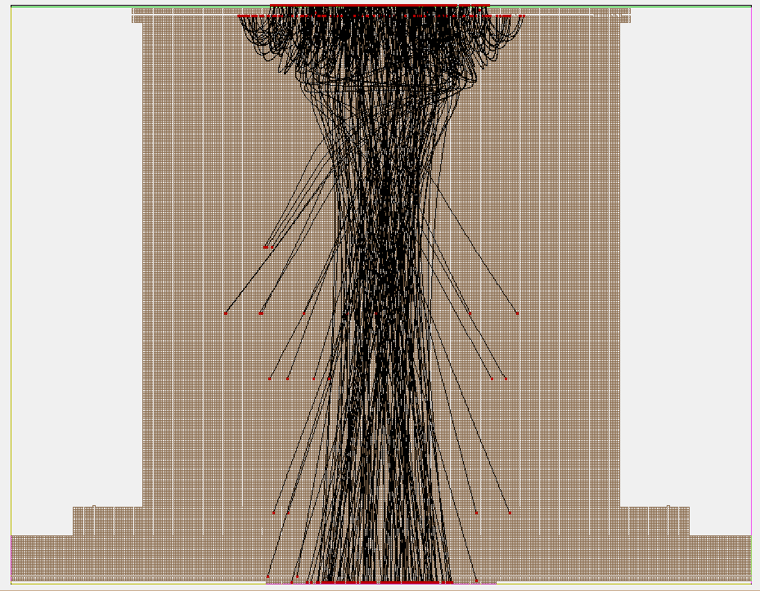
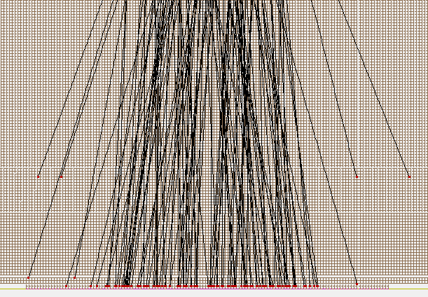
How are the counts determined good or bad?
Green Circle: Counted as impact on anode
Red Circle: Not counted as impact on anode
+y
y=0.2
In the data, if the ending position has a y=0.2,
then it must have impacted the anode

Slide 9
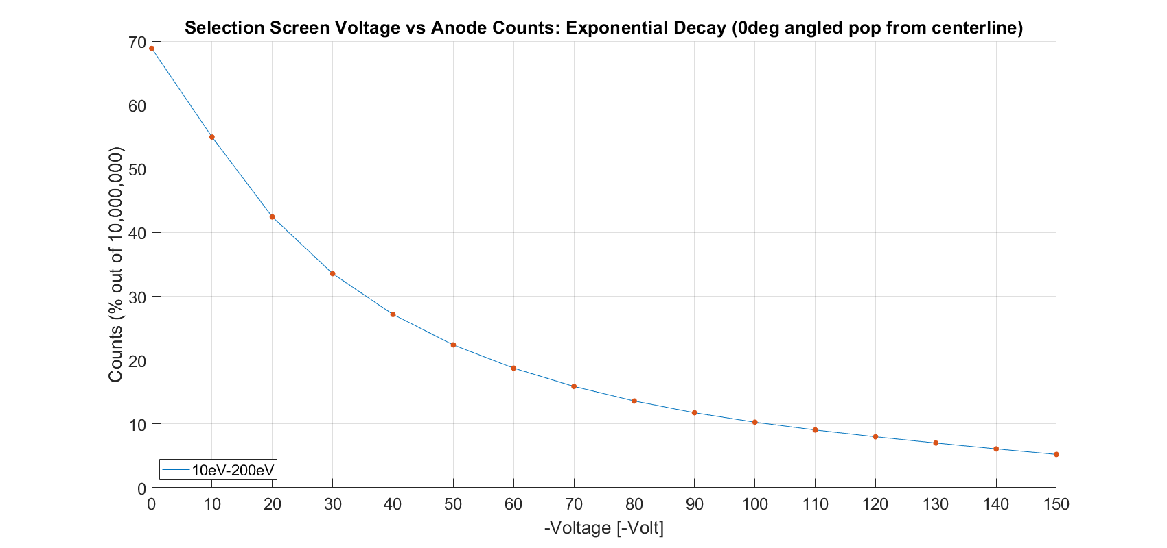
Results for 0deg from instrument centerline

Slide 10
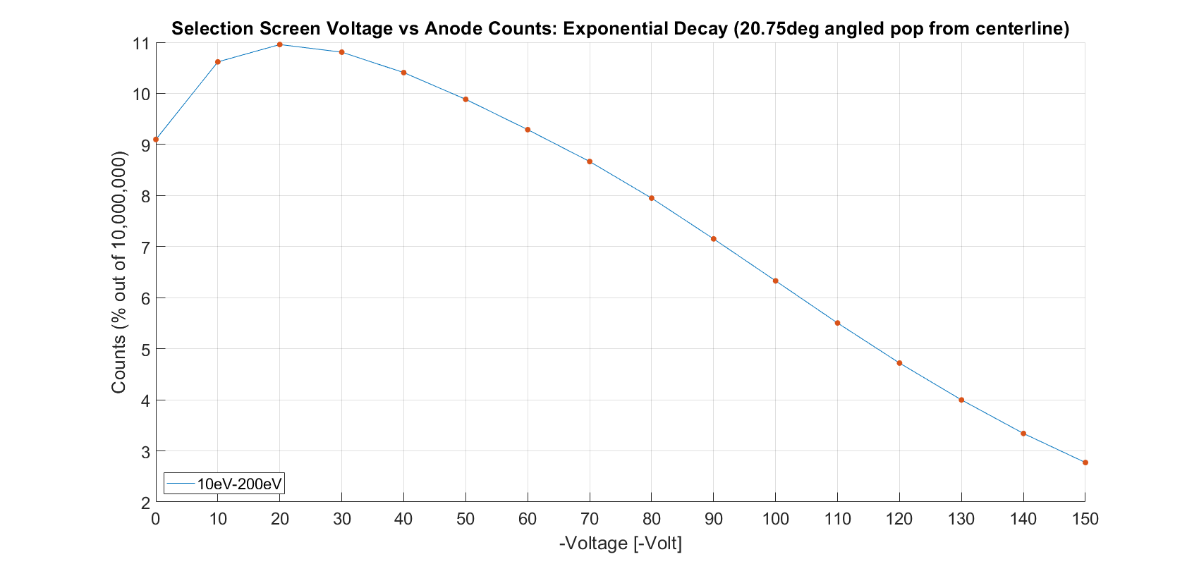
Results for 20.75 deg from instrument centerline

Slide 11
Results Cont. for 20.75 deg from instrument centerline
 | 0 deg | 20.75 deg
0V | 68.8569% | 9.09789%
10V | 54.96255% | 10.61697%
20V | 42.44379% | 10.95631%
30V | 33.55489% | 10.80712%
40V | 27.164% | 10.40667%
50V | 22.39137% | 9.88369%
60V | 18.74281% | 9.28968%
70V | 15.87906% | 8.66522%
80V | 13.59662% | 7.94821%
90V | 11.74904% | 7.15128%
100V | 10.27077% | 6.32928%
110V | 9.04964% | 5.50376%
120V | 7.98975% | 4.71944%
130V | 7.01099% | 3.99775%
140V | 6.08838% | 3.34093%
150V | 5.21776% | 2.77194%
Counts as percentages compared to the 10mil population
Counts are registered only when they impact the anode face

